Slide 1
Self-organising
Neural Networks
(Competitive Learning)
by
Greg

Slide 2
Neural Network based on Competition
Competitive Learning: Another popular type of unsupervised learning.
Neurons compete among themselves to be activated.
  only a single output neuron is active at any time.
The output neuron that wins the ‘competition’ is called the Winner-Takes-All neuron.
JST - Bidirectional Associative Memory

Slide 3
Neural Network based on Competition
The net seeks to find patterns or regularity in the input data.
Competitive learning NNs:
  Fixed-weight Competitive Nets
    Maxnet
    Mexican Hat
    Hamming Net
  Kohonen Self-Organizing Maps (SOM)
  Learning Vector Quantization
  Counterpropagation
JST - Bidirectional Associative Memory

Slide 4
Maxnet
Proposed by R. P. Lippmann in 1987
It can be use to pick the node whose input is the largest.
The m nodes in Maxnet are completely interconected.
  Symmetric weights
No Training Algorithm
  The weights are fixed
JST - Bidirectional Associative Memory

Slide 5
Maxnet Architecture
1
1
A₁
-ε
A_{m}
-ε
-ε
-ε
-ε
A_{i}
A_{j}
-ε
1
1
JST - Bidirectional Associative Memory

Slide 6
Maxnet
Activation Function
JST - Bidirectional Associative Memory

Slide 7

Maxnet Algorithm (Fausett, 1994)
JST - Bidirectional Associative Memory

Slide 8
Maxnet Example
Example: ε = 0.2 (range 0 s/d 0.25)
Initial activation (input signals):
a₁(0) = 0.2 a₂(0) = 0.4
a₃(0) = 0.6 a₄(0) = 0.8
Step 1: Iterasi 1
  Step 2:
  a₁(1) = f[1*a₁(0) + (- ε) *a₂(0) + (- ε) *a₃(0) + (- ε) *a₄(0)]
  a₁(1) = f[0.2 – 0.08 – 0.12 – 0.16] = f[-0.16] = 0
  a₂(1) = f[0.4 – 0.04 – 0.12 – 0.16] = f[0.08] = 0.08
  a₃(1) = f[0.6 – 0.04 – 0.08 – 0.16] = f[0.32] = 0.32
  a₄(1) = f[0.8 – 0.04 – 0.08 – 0.12] = f[0.56] = 0.56
  Step 3: a₁(old) = a₁(new) = 0 a₂(old) = a₂(new) = 0.08
  a₃(old) = a₃(new) = 0.32 a₄(old) = a₄(new) = 0.56
  Step 4: more than one node has a nonzero activation ⇒ Continue
JST - Bidirectional Associative Memory

Slide 9
Maxnet Example
Step 1: Iterasi 2
  Step 2:
  a₁(2) = f[1*a₁(1) + (- ε) *a₂(1) + (- ε) *a₃(1) + (- ε) *a₄(1)]
  a₁(2) = f[0 – 0.016 – 0.064 – 0.112] = f[-0.192] = 0
  a₂(2) = f[-0.096] = 0
  a₃(2) = f[0.192] = 0.192
  a₄(2) = f[0.48] = 0.48
Step 1: Iterasi 3
  Step 2: a₁(3) = 0 a₂(3) = 0 a₃(3) = 0.096 a₄(3) = 0.442
Step 1: Iterasi 4
  Step 2: a₁(4) = 0 a₂(4) = 0 a₃(4) = 0.008 a₄(4) = 0.422
Step 1: Iterasi 5
  Step 2: a₁(5) = 0 a₂(5) = 0 a₃(5) = 0. a₄(5) = 0.421
  Step 3: a₁(old) = 0 a₂(old) = 0 a₃(old) = 0. a₄(old) = 0.421
  Step 4: Only one node has a nonzero activation ⇒ STOP
JST - Bidirectional Associative Memory

Slide 10
Mexican Hat Network
Created by Teuvo Kohonen in 1989
A general Contrast-Enhancing algorithm
Each neuron is connected with excitatory (positive weight) links to the ‘cooperative neighbors’, neurons that are in close proximity.
Each neuron is connected with inhibitory (negative weight) links to the ‘competitive neighbors’, neurons that are somewhat further away.
There may be a number of neurons to which the neuron is not connected, neurons that are more further away than the ‘competitive neighbors’.
The neurons receive an external signal.
JST - Bidirectional Associative Memory

Slide 11
Mexican Hat Architecture
w₀
w₂
w₂
w₁
w₁
X_{i-4}
X_{i-3}
X_{i-2}
X_{i-1}
X_{i}
X_{i+1}
X_{i+2}
X_{i+3}
X_{i+4}
w₃
w₃
s_{i}
JST - Bidirectional Associative Memory

Slide 12
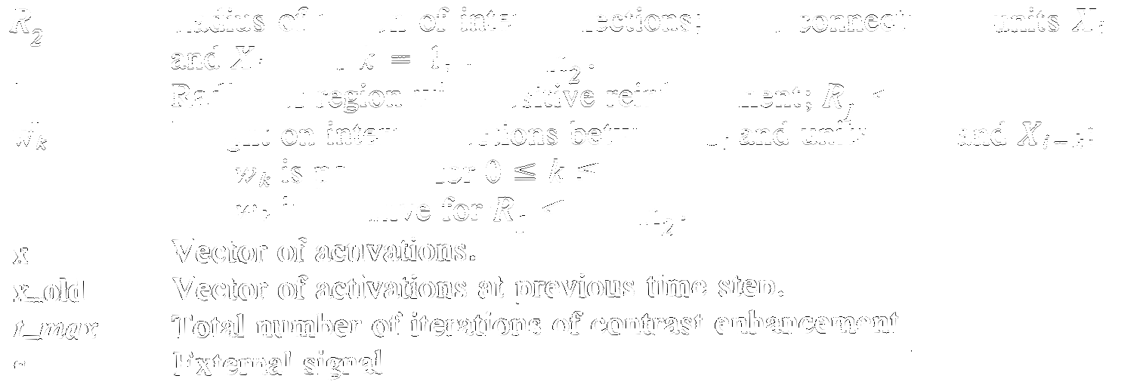
Mexican Hat Algorithm
Variables definition:
x_max Ramp function (0 – x_max)
JST - Bidirectional Associative Memory

Slide 13
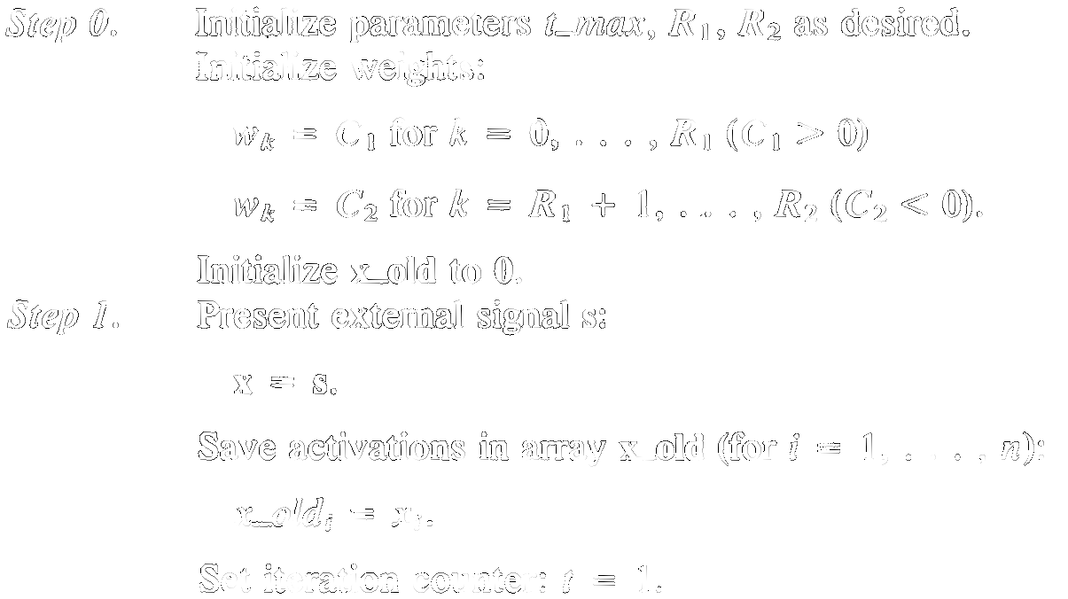
Mexican Hat Algorithm (Fausett, 1994)
JST - Bidirectional Associative Memory

Slide 14
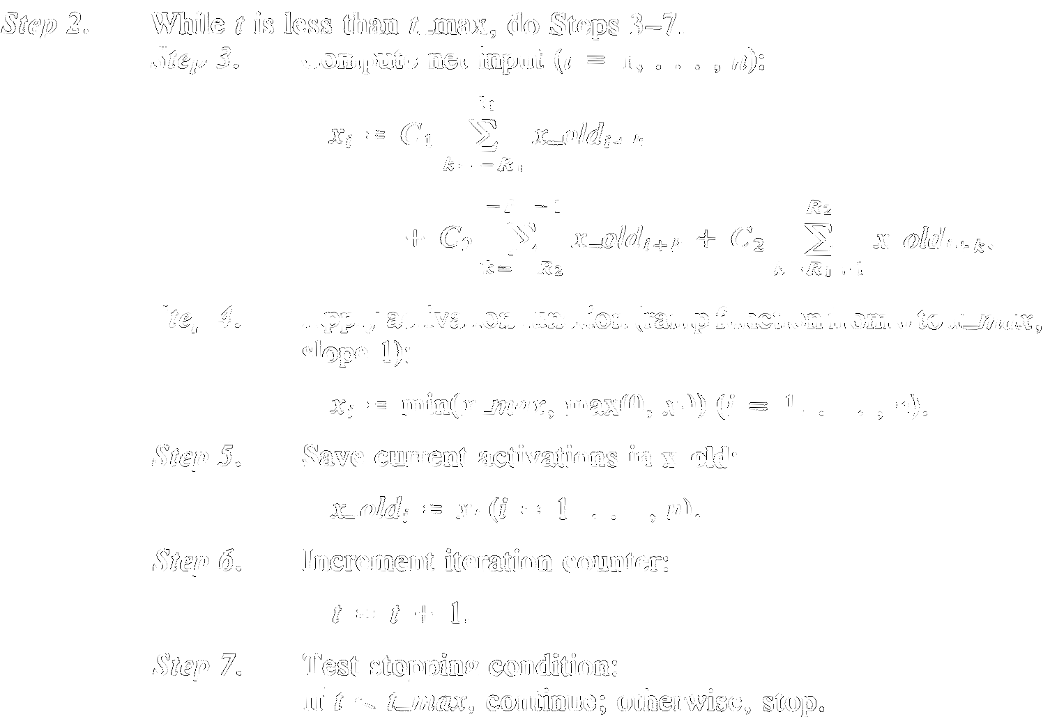
Mexican Hat Algorithm (Fausett, 1994)
JST - Bidirectional Associative Memory

Slide 15
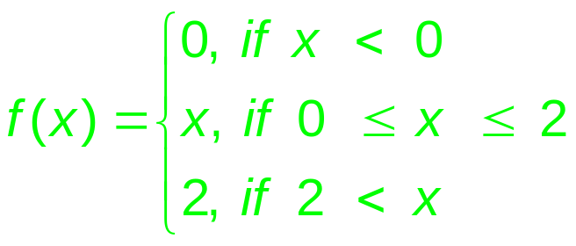
Mexican Hat Example
Example: Simple net with 7 unit (node)
Activation function:
Step 0: Initialize Parameters
R1 = 1 R2 = 2
C1 = 0.6 C2 = -0.4
X_old = 0 t_max = 3
Step 1: (t = 0)
X ⇐ S = (0.0 , 0.5 , 0.8 , 1.0 , 0.8 , 0.5 , 0.0)
for (i = 1, …, n)
x_old[i] = x[i]
x_max
JST - Bidirectional Associative Memory

Slide 16
Mexican Hat Example
Step 2: (t = 1)
Formula:
x₁ = 0.6 x_old₁ + 0.6 x_old₂ – 0.4 x_old₃
x₂ = 0.6 x_old₁ + 0.6 x_old₂ +0.6 x_old₃ – 0.4 x_old₄
x₃ = -0.4 x_old₁ + 0.6 x_old₂ + 0.6 x_old₃ +0.6 x_old₄ – 0.4 x_old₅
x₄ = -0.4 x_old₂ + 0.6 x_old₃ + 0.6 x_old₄ +0.6 x_old₅ – 0.4 x_old₆
x₅ = -0.4 x_old₃ + 0.6 x_old₄ + 0.6 x_old₅ +0.6 x_old₆ – 0.4 x_old₇
x₆ = -0.4 x_old₄ + 0.6 x_old₅ + 0.6 x_old₆ +0.6 x_old₇
x₇ = -0.4 x_old₅ + 0.6 x_old₆ + 0.6 x_old₇
JST - Bidirectional Associative Memory

Slide 17
Mexican Hat Example
Step 2: (t = 1)
Step 3:
x₁ = 0.6 (0.0) + 0.6 (0.5) – 0.4 (0.8) = -0.2
x₂ = 0.6 (0.0) + 0.6 (0.5) + 0.6 (0.8) – 0.4 (1.0) = 0.38
x₃ = -0.4 (0.0) + 0.6 (0.5) + 0.6 (0.8) +0.6 (1.0) – 0.4 (0.8) = 1.06
x₄ = -0.4 (0.5) + 0.6 (0.8) + 0.6 (1.0) +0.6 (0.8) – 0.4 (0.5) = 1.16
x₅ = -0.4 (0.8) + 0.6 (1.0) + 0.6 (0.8) +0.6 (0.5) – 0.4 (0.0) = 1.06
x₆ = -0.4 (1.0) + 0.6 (0.8) + 0.6 (0.5) +0.6 (0.0) = 0.38
x₇ = -0.4 (0.8) + 0.6 (0.5) + 0.6 (0.0) = -0.2
Step 4: x = (0.0 , 0.38 , 1.06 , 1.16 , 1.06 , 0.38 , 0.0)
Step 5: x_old = x
Step 6: t = t + 1 = 2
Step 7: t < t_max ⇒ true; Continue
JST - Bidirectional Associative Memory

Slide 18
Mexican Hat Example
Step 2: (t = 2)
Step 3:
x₁ = 0.6 (0.0) + 0.6 (0.38) – 0.4 (1.06) = -0.196
x₂ = 0.6 (0.0) + 0.6 (0.38) + 0.6 (1.06) – 0.4 (1.16) = 0.39
x₃ = -0.4 (0.0) + 0.6 (0.38) + 0.6 (1.06) +0.6 (1.16) – 0.4 (1.06) = 1.14
x₄ = -0.4 (0.38) + 0.6 (1.06) + 0.6 (1.16) +0.6 (1.06) – 0.4 (0.38) = 1.66
x₅ = -0.4 (1.06) + 0.6 (1.16) + 0.6 (1.06) +0.6 (0.38) – 0.4 (0.0) = 1.14
x₆ = -0.4 (1.16) + 0.6 (1.06) + 0.6 (0.38) +0.6 (0.0) = 0.39
x₇ = -0.4 (1.06) + 0.6 (0.38) + 0.6 (0.0) = -0.196
Step 4: x = (0.0 , 0.39 , 1.14 , 1.66 , 1.14 , 0.39 , 0.0)
Step 5: x_old = x
Step 6: t = t + 1 = 3
Step 7: t < t_max ⇒ false; STOP
JST - Bidirectional Associative Memory

Slide 19
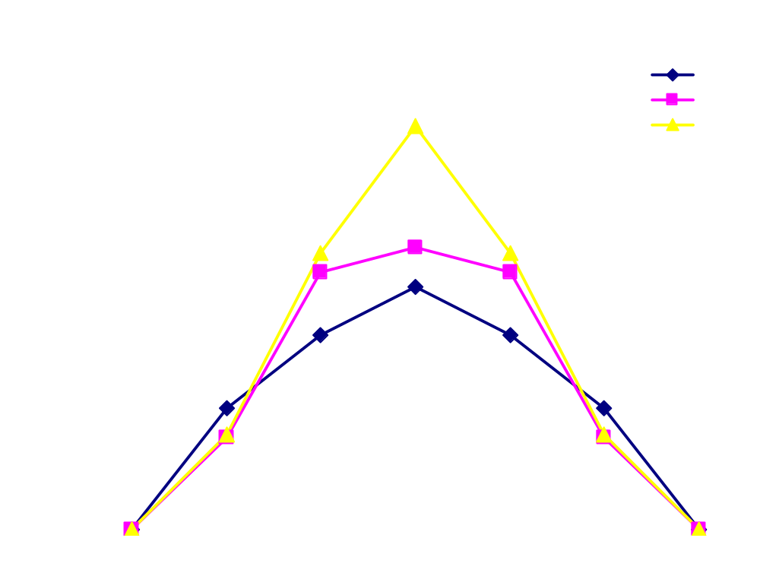
Mexican Hat Example
JST - Bidirectional Associative Memory

Slide 20
Hamming Net
Created by R. P. Lippmann in 1987 and Darpa in 1988.
A Maximum Likelihood Classifier
  Can be used to determine which of exemplar vectors is most similar to input vector.
  The hamming distance between two vector is the number of components in which the vectors differs.
Hamming Net uses Maxnet as a subnet to find the unit with the largest net input.
JST - Bidirectional Associative Memory

Slide 21
Hamming Net Architecture
MAXNET
Y₁
Y₂
…
Y_{m}
w₁₁
w₁₂
w_{n2}
w_{nm}
w₂₂
w₃₂
w_{1m}
w_{2m}
w₃₁
w_{n1}
w₂₁
w_{3m}
X₁
X₂
X₃
…
X_{n}
JST - Bidirectional Associative Memory

Slide 22


Hamming Net Algorithm (Fausett, 1994)
JST - Bidirectional Associative Memory

Slide 23

Hamming Net Algorithm (Fausett, 1994)
JST - Bidirectional Associative Memory

Slide 24
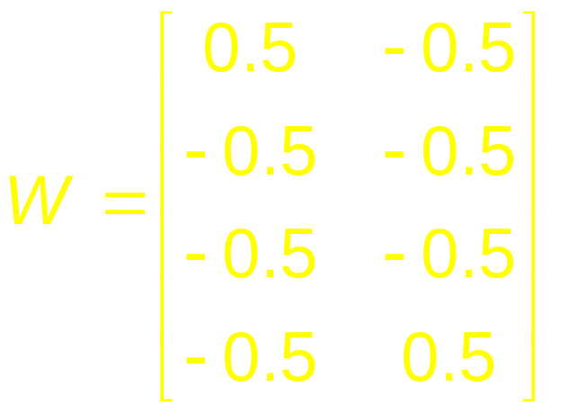
Hamming Net Example
Exemplar Vectors: e(1) = ( 1, -1, -1, -1 ) e(2) = ( -1, -1, -1, 1 )
Testing Input Patterns: a = ( 1, 1, -1, -1 ) b = ( 1, -1, -1, -1 )
c = ( -1, -1, -1, 1 ) d = ( -1, -1, 1, 1 )
Step 0: Store the m exemplar vectors in the weights:
Initializes the biases: b_{j} = n/2
b₁ = b₂ = 2
JST - Bidirectional Associative Memory

Slide 25
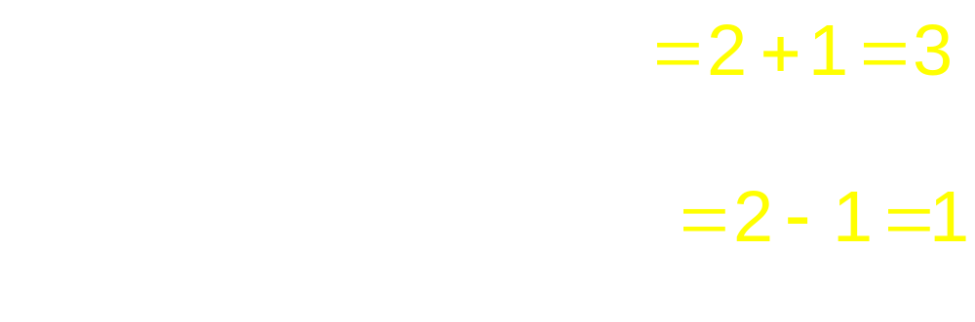
Hamming Net Example
Step 1: x = a = ( 1, 1, -1, -1 )
Step 2:
Step 3: Initialize MAXNET
y₁(0) = y_in₁=3 ; y₂(0) = y_in₂ = 1
Step 4: Output MAXNET = Y₁ = e(1) = ( 1, -1, -1, -1 )
JST - Bidirectional Associative Memory

Slide 26
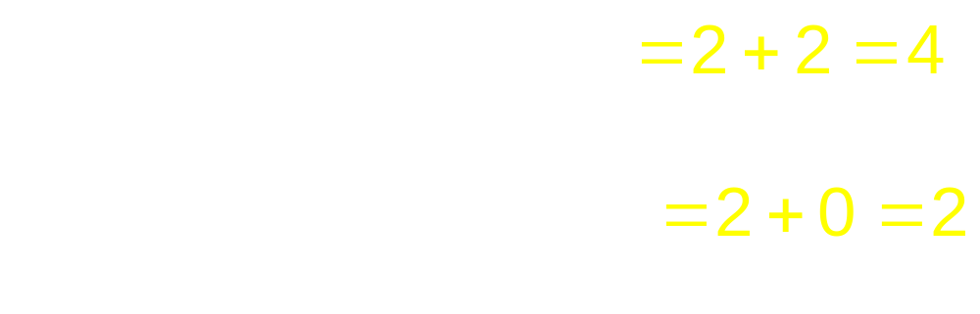
Hamming Net Example
Step 1: x = b = ( 1, -1, -1, -1 )
Step 2:
Step 3: Initialize MAXNET
y₁(0) = y_in₁=4 ; y₂(0) = y_in₂ = 2
Step 4: Output MAXNET = Y₁ = e(1) = ( 1, -1, -1, -1 )
JST - Bidirectional Associative Memory

Slide 27
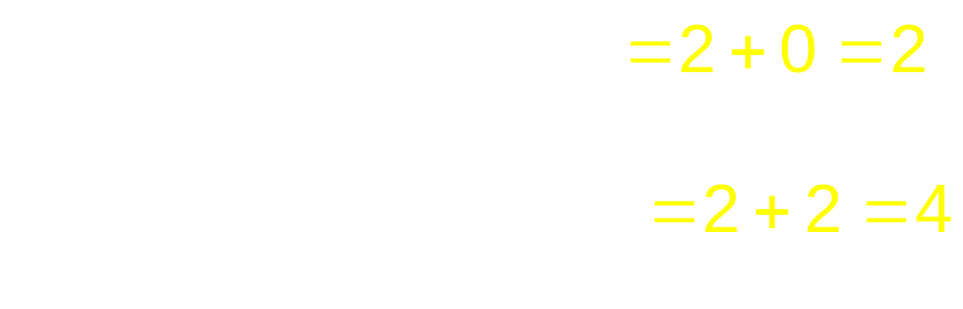
Hamming Net Example
Step 1: x = c = ( -1, -1, -1, 1 )
Step 2:
Step 3: Initialize MAXNET
y₁(0) = y_in₁=2 ; y₂(0) = y_in₂ = 4
Step 4: Output MAXNET = Y₂ = e(2) = ( -1, -1, -1, 1 )
JST - Bidirectional Associative Memory

Slide 28
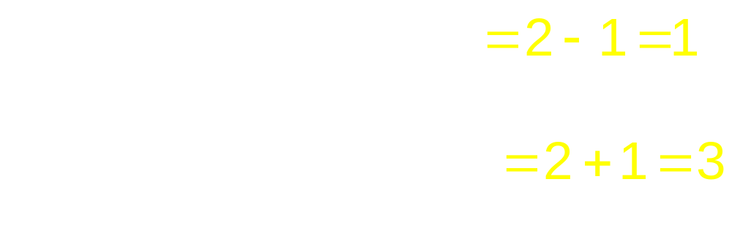
Hamming Net Example
Step 1: x = d = ( -1, -1, 1, 1 )
Step 2:
Step 3: Initialize MAXNET
y₁(0) = y_in₁=1 ; y₂(0) = y_in₂ = 3
Step 4: Output MAXNET = Y₂ = e(2) = ( -1, -1, -1, 1 )
JST - Bidirectional Associative Memory

Slide 29
Exercise
Maxnet: (Point 5)
Example: ε = 1/5 = 0.2
Initial activation (input signals):
a₁(0) = 0.7 a₂(0) = 0.3 a₃(0) = 0.5
a₄(0) = 0.9 a₅(0) = 0.1
Mexican Hat: Simple net with 9 unit (node) (Point 5)
Activation function:
Initialize Parameters
R1 = 1 R2 = 3 C1 = 0.4 C2 = -0.5
X_old = 0 t_max = 3
S = (0.5 , 1.0 , 0.3 , 0.0 , 0.4 , 0.8 , 0.2 , 0.7, 0.9)
JST - Bidirectional Associative Memory

